Slide 1
Laravel certificate course

Slide 2
Diya kirit patel sybca batch-B 23000119

Slide 3
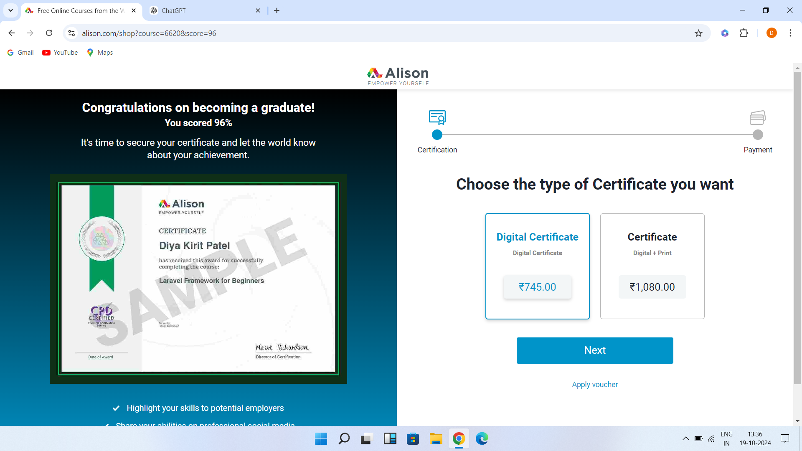

Slide 4
Module 1: Intoduction to laravel

Slide 5
what is laravel purpose?
Laravel is a tool that speeds up web development by providing ready-made components, libraries, and tools. It simplifies common tasks like managing routes (URLs), user logins, caching, and sessions, so developers can focus on building unique features instead of starting from scratch each time.

Slide 6

Advantages
Advantages
Easy to read code
Well-Organized Structure
User Login Ready
Safe Database Changes
Easy Database Handling
Strong Security

Slide 7
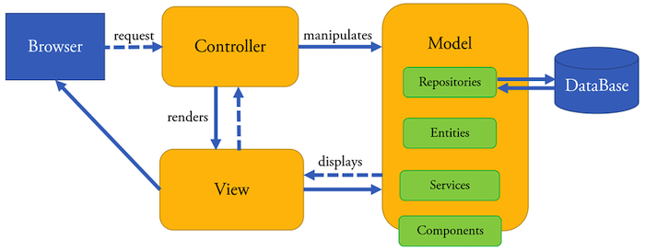
MVC Architecture
The Model-View-Controller (MVC) architecture in Laravel separates an app into three parts: Model (handles data and database), View (displays what the user sees), and Controller (connects the Model and View, handling logic). This structure helps keep the code organized and easier to manage.

Slide 8
Purpose: Purpose: Manages app data, business rules, and interacts with the database.
Significance in Laravel: Models are PHP classes linked to database tables, handling data operations like create, read, update, and delete (CRUD) while enforcing rules.
Purpose: Displays data to users using HTML, CSS, and JavaScript.
Significance in Laravel: Views use Blade templates or PHP to create dynamic, reusable layouts that show data from Controllers.
Purpose: Acts as the middleman between Model and View, handling user requests and sending data for display.
Significance in LaravelControllers are PHP classes with methods that get data from Models and pass it to Views for users to see.
Model(M) :
View(V) :
Controller(C) :

Slide 9
Significance of MVC in Laravel
Separation of Concerns
Code Reusability
Scalability and Maintainability

Slide 10
MVC in the Laravel
Model(M) is represented by Eloquent ORM entity:
View(V) is represented by Blade Templates:
Controller(C) is represented by the corresponding classes:

Slide 11
Laravel Framework Key Folders
- App: This is the core of your Laravel application. It includes:
Console: Contains Artisan commands.
Exceptions: Manages exception handling.
Http: Contains controllers, middleware, form requests, and route definitions.
Models: Houses the application's data models.
Providers: Manages service providers.
- Bootstrap: Contains files responsible for starting up the Laravel application and loading essential components.
- Config: Holds configuration files for settings like database connections, caching, and more.
- Database: Manages database-related files:
Migrations: Contains migration files for database schema changes.
Seeds: Stores seed files to populate the database with test data.

Slide 12
Module 1 summary
Laravel simplifies building modern, feature-rich web applications.
Artisan, the command-line tool, handles tasks like project setup, migrations, and testing.
Eloquent ORM makes database management easy with intuitive syntax for records and relationships.
Blade templating engine allows for dynamic, reusable views.
Laravel promotes clean, maintainable code with best practices.
Laravel follows the MVC pattern:
Model: Manages data and interacts with the database.
View: Displays data to users with dynamic content via Blade.
Controller: Bridges the Model and View, handling user input and responses.

Slide 13
MVC promotes code organization, separation of concerns, and maintainability, facilitating collaboration among developers.
The lesson covered how to initialize a Laravel project using Composer and Artisan.
Running `composer create-project laravel/laravel project-name` quickly sets up a new Laravel project with the required directory structure and dependencies.
The contents of the artisan file were explored, highlighting its role in executing various project management commands.
Essential configuration files, such as .env, were discussed for managing environment-specific settings.

Slide 14
Module 2: Web Application Developing

Slide 15
Active Record Introduction
Active Record is a design pattern that allows for object-oriented access to data in a database.It combines the business logic with the model, enabling developers to work with the database using a simple and easy-to-understand API.
Eloquent ORM in Laravel is an implementation of the Active Record pattern.

Slide 16
key concepts and features related to the Active Record pattern:
Model Representation :In Active Record, a model class represents a database table, and each instance of the model corresponds to a record in that table.
CRUD Operations :Active Record simplifies database interactions by offering methods for Create, Read, Update, and Delete (CRUD) operations, such as create, find, update, and delete in models.
Relationships : Active Record simplifies managing relationships between tables, with Eloquent models defining relationships like one-to-one, one-to-many, and many-to-many using methods such as hasOne, hasMany, and belongsTo.
Validation : Active Record models often include validation rules, and Laravel's Eloquent allows you to define these validation rules for model attributes.

Slide 17
Migrations in the Laravel
In Laravel, migrations are an efficient way to manage database schema changes and version control, allowing you to define and modify the structure of database tables easily. You can create a new migration using the `make:migration` Artisan command.

Slide 18
Eloquent in the Laravel
In Laravel, Eloquent Models are the backbone of database interaction, providing an elegant and expressive way to work with databases.
They act as an abstraction layer, representing tables in the database and allowing intuitive, object-oriented data manipulation.
Eloquent replaces the need for raw SQL queries and simplifies database connection management with clean syntax.
By convention, Eloquent Models are placed in the app/Models directory, but you can customize their location if needed.
To create a new model, use the command: `php artisan make:model YourModel`.
This command generates a new Eloquent Model file named YourModel.php in the app/Models directory by default, representing data from the your_models table, allowing you to get, create, update, and delete entities.

Slide 19
Blade Engine Directives
Blade comes with convenient directives for control structures, making it easy to implement logic in your views. There are some popular directives: @section, @show, @yield, @extends, @include, @for, @foreach, @if, @else.

Slide 20
Controller Introduction
In Laravel, a controller is a class that manages incoming HTTP requests and application logic to generate the appropriate HTTP response. It acts as a bridge between the model (which handles data and business logic) and the view (which displays the user interface), helping to enforce the separation of concerns in the MVC (Model-View-Controller) architecture.

Slide 21
Key purposes of Laravel controllers
Handling HTTP Requests
Application Logic
Routing and Actions
Response Generation

Slide 22
Define Controller
Method 1: Using Artisan Command
To create a new controller using the Artisan command-line tool, open your terminal and navigate to your Laravel project's root directory.
Method 2: Manual Creation
Create a new PHP file in the app/Http/Controllers directory.

Slide 23
Module 2 Summary
Controllers serve as intermediaries between the user interface and application logic, processing user input and returning responses.
We learned to create controllers using Laravel's Artisan command-line tool for better organization of application logic.
Resource controllers streamline the creation of CRUD (Create, Read, Update, Delete) operations.
Laravel's routing system determines how the application responds to HTTP requests, linking specific routes to controller methods.
We discussed creating both basic and resourceful routes, with resourceful routes simplifying CRUD operations.
Route parameters and naming conventions were covered to enable dynamic and customizable routes.

Slide 24
Models represent data structures in the application and interact with the database, encapsulating business logic for data manipulation.
Laravel's Eloquent ORM simplifies database interactions with an expressive syntax for querying and modifying records.
We learned to create models, define relationships between them, and use Eloquent for common database operations.
Views present the application's data to users and define the structure and layout of the user interface.
Blade, Laravel's templating engine, allows for the creation of dynamic and reusable views, using directives and control structures.
The lesson covered integrating views with controllers to enable data passing for dynamic content rendering.

Slide 25
Thank you

